Slide 1
Microcalcification detection, clustering and features extraction
Presentation of 21/08/2023

Slide 2
I) Background, reminder of last meeting
II) Specific csv table for Elisaveth and George
III) Datasets, matlab features
INbreast
DDSM
Matlab features, clusters
IV) Compare with INbreast ground truth (XML file)
XML and ROI file
Results
IV) Opening

Slide 3
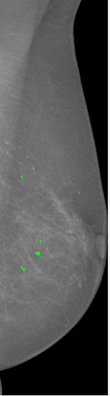
I) Background, reminder of last meeting
Last time :
Try on INbreast dataset
Extract functions
Problems with DDSM dataset loader
Settled objectives :
Smalls change on the saving function for the table, send a table with 5 patients to George
Estimate accuracy with ground truth (INbreast xml file)
Receive a part of DDSM dataset loaded by Grigorios and try it
Breath density INbreast -> threshold ?
Inbreast mammogram, detection

Slide 4
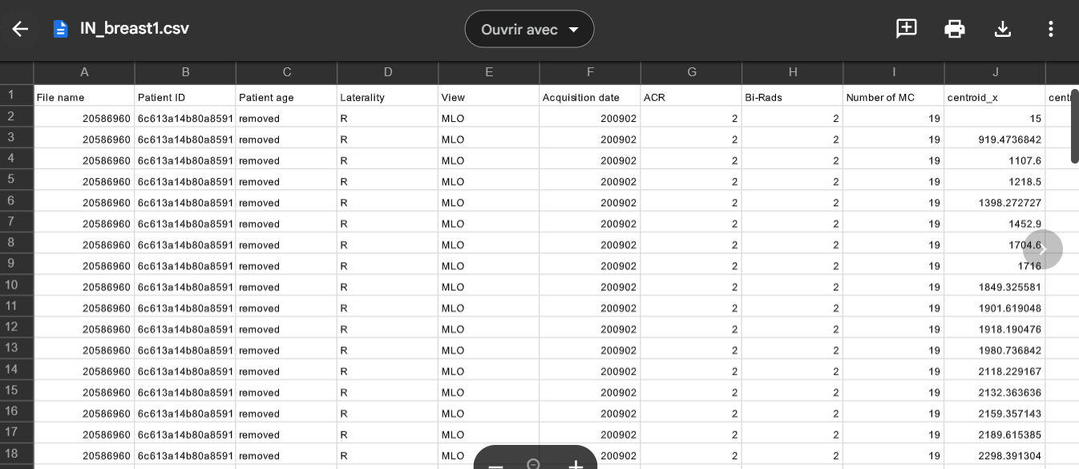
II) Specific csv table for Elisaveth and George
-Function completed, can write a specific MC_table with or without INbreast corresponding metadata
Show csv table
A table has been made with 6 INbreast mammograms

Slide 5

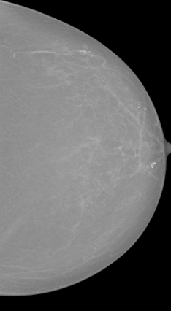

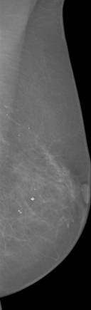
III) Datasets
Show saved images in folder
1) INbreast
2 Inbreast mammograms, and their corresponding detection mask

Slide 6
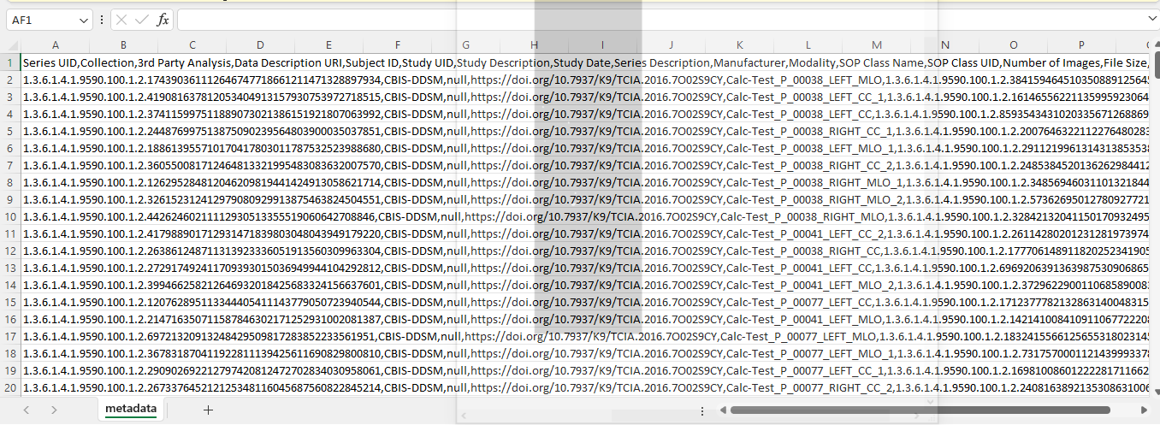
2) DDSM
- Seems performant overall, no saved images and no more ressources at the moment (used too much on Collab and a GPU is required)
- Problems with the metadata:
DDSM metadata
Show csv file

Slide 7
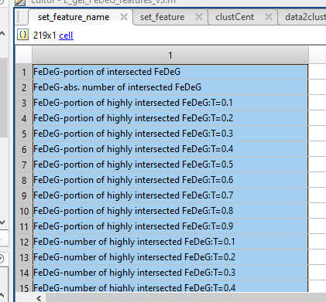
3) Matlab Features
Show MATLAB
- 4 variables I’m interested in : clustCent, data2cluster (cluster locations and information) and set_feature, set_feature_name :
set_feature -> The values
set_feature_name -> The corresponding names
219 features !!
Already a function in the making, the question is which features should I keep ?
Should the clusters locations and features be stored in the same csv table as the metadata and MC locations and features. Or in a csv table apart.
Corresponding variables
HPV_extract_cluster_features and HPV_exporting_matlab_csv_tables

Slide 8

IV) Compare with INbreast ground truth (XML file)
1) XML and ROI file
-I first tried with the ROI file and « Osirix » but didn’t succeed in opening it, so I tried with XML file :
Extract of READme INbreast
Show XML on vscode
-Problems to compare (=required same dimensions and transformations as the transformed mammogram ):
-> Probably a dataset tailored for MATLAB (inversed x and y in comparison with python)
-> Modified output of mamms_preprocess .py function

Slide 9
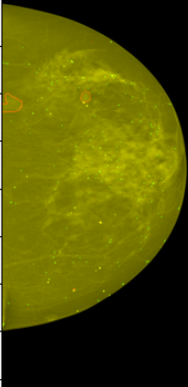
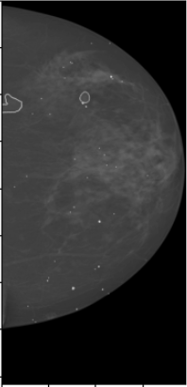
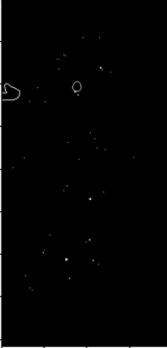
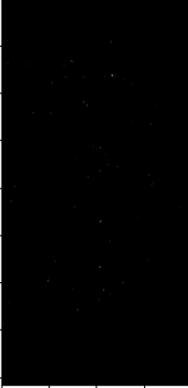
2) Results
-For now, it’s a subplot, later on I’m thinking of making a « score-function »
- Overall good-looking with a zoom but some case :
Ground truth subplot on mamm
Ground truth mask
Detection mask (probably th too high there)
Mamm + ground truth (red) + detection (green)

Slide 10
V) Opening
Score function
Threshold (tried some but nothing convincing) ?
Metadata DDSM
Finish with MATLAB features
Order the code

